Slide 1
THE GRC PANEL
ENVELOPE TO A BUILDING STRUCTURE
GRC FACADES
CREATING LANDMARKS

Slide 2
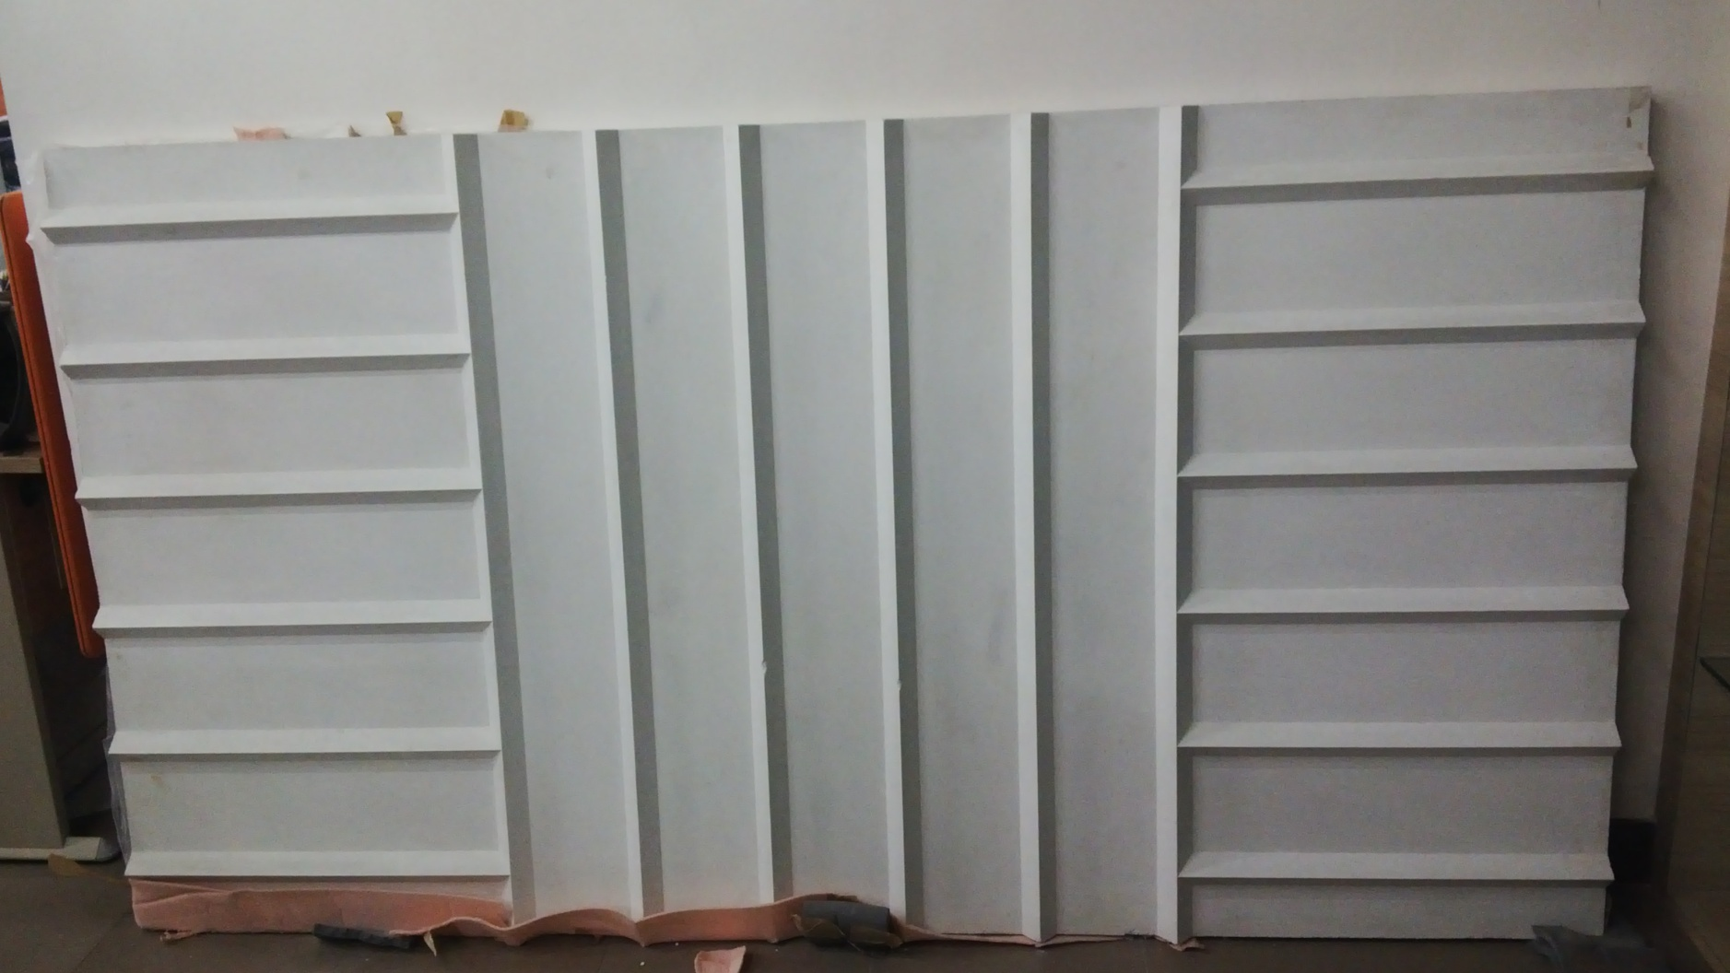
GEC PANEL SAMPLE FOR
TAJ GAUHATI

Slide 3
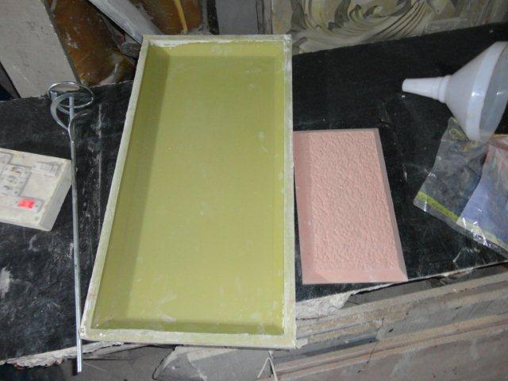
THE TYPICAL PANEL MOLD

Slide 4
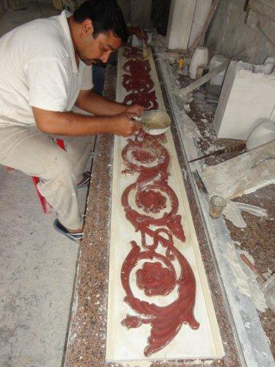
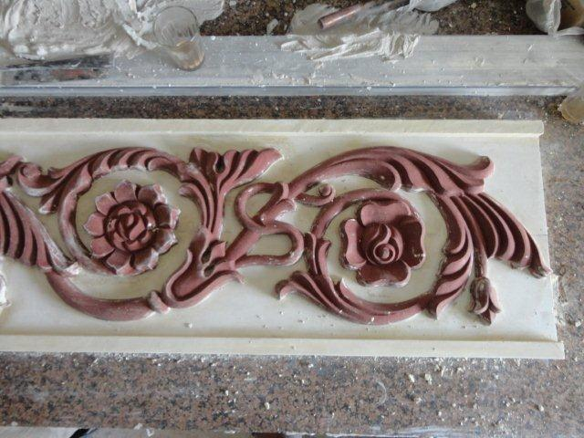
PATTERN WORK OF A DECORATIVE PANEL

Slide 5
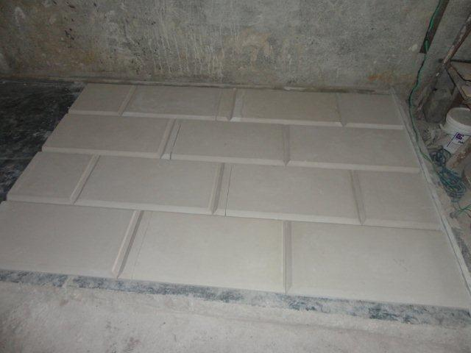
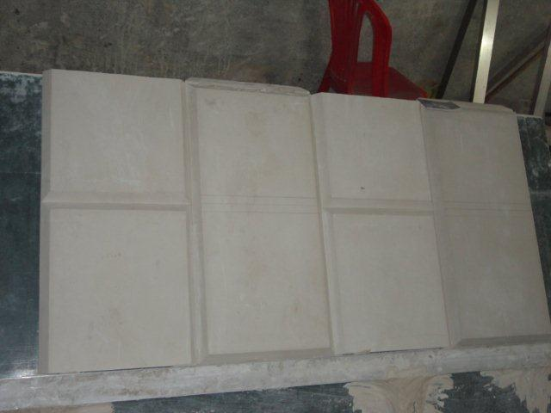
THE PATTERN WORK
FLAT PANEL
CORNER PANEL

Slide 6
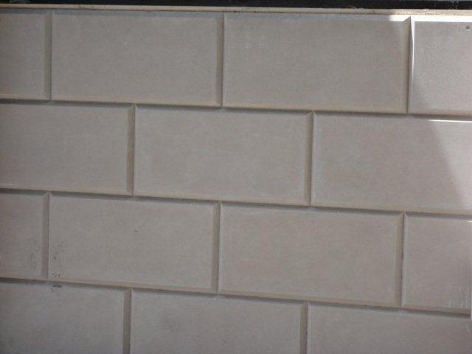
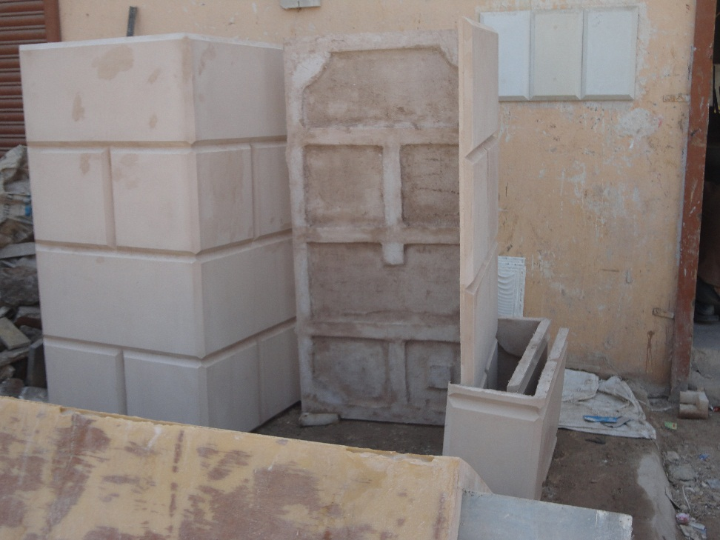
PATTERN TO GRC ELEMENT
THE FLAT PANEL
THE GRC ELEMENT

Slide 7
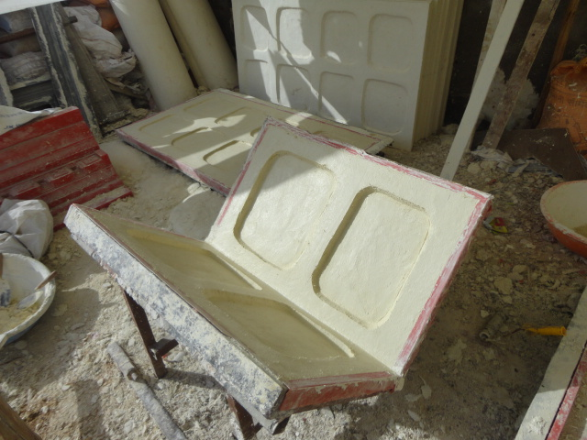
CORNER MOULD OF A PANEL FOR A PERFECT RIGHT ANGLE ON THE EXTERIOR
BANDS FOR PANEL RIGIDITY & STRENGTH - BACK OF A PANEL WITH GRC

Slide 8
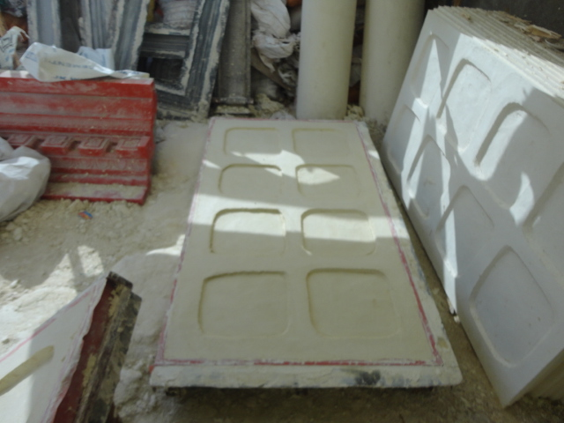
GRC PANEL – BACK SIDE
WITH BAND ALL ALONG THE PANEL, STIFFENERS & RIBS INBETWEEN THE BAND ON THE BACK SIDE

Slide 9
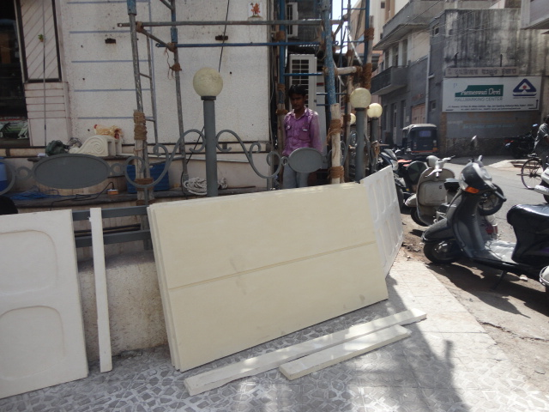
THE GRC PANEL – WITH A GROOVE
READY FOR INSTALLATION AT SITE

Slide 10
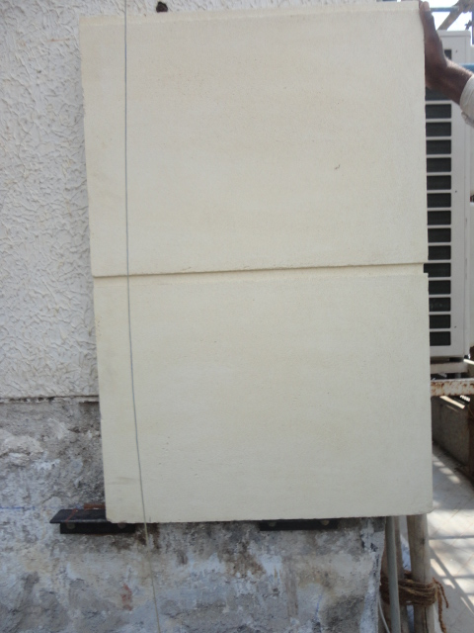
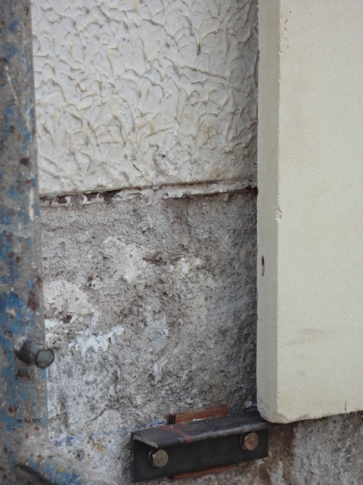
CORNER GRC PANEL
STEEL BRACKETS SUPPORTING THE PANEL SO THAT EVERY PANEL SUPPORTS ITS OWN WEIGHT

Slide 11
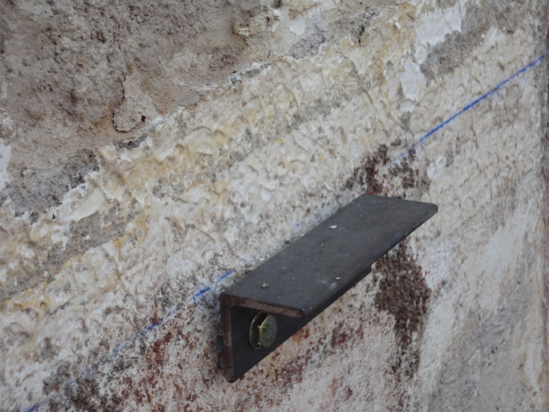
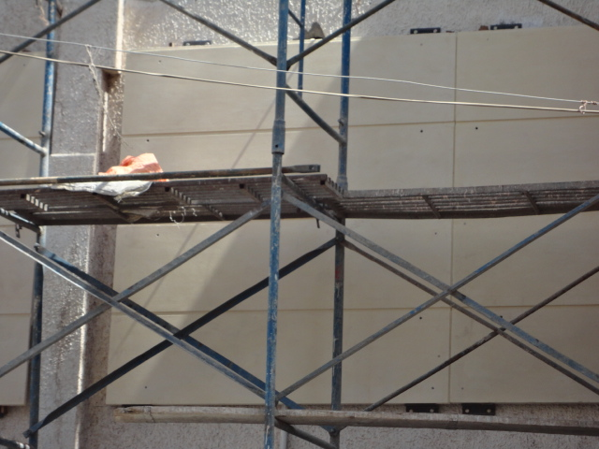
GRC PANEL
STEEL BRACKETS SUPPORTING THE PANEL

Slide 12
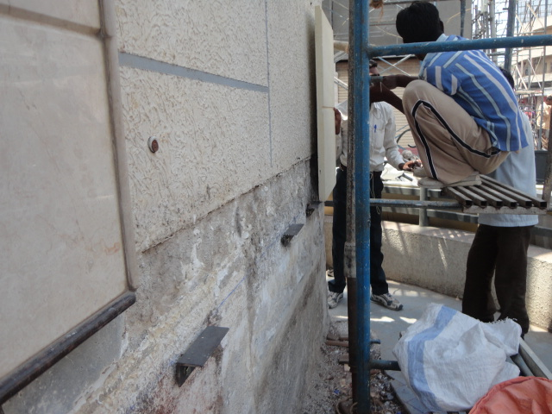
LEVELLING & INSTALLATION

Slide 13
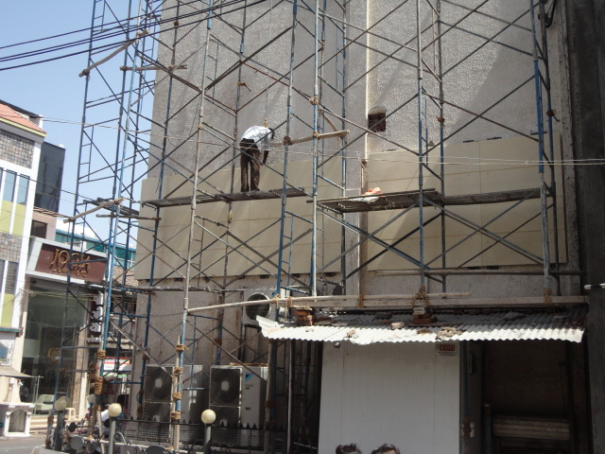
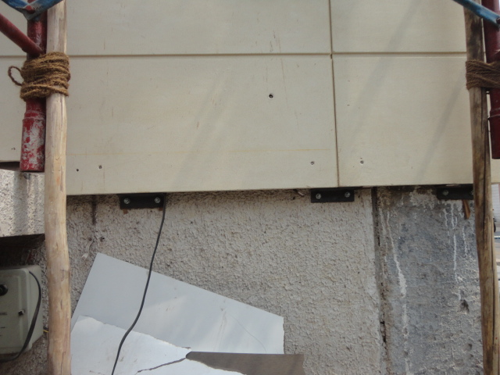
LEVELLING & INSTALLATION

Slide 14
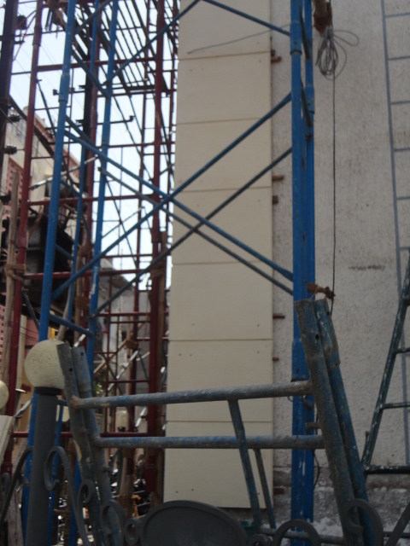
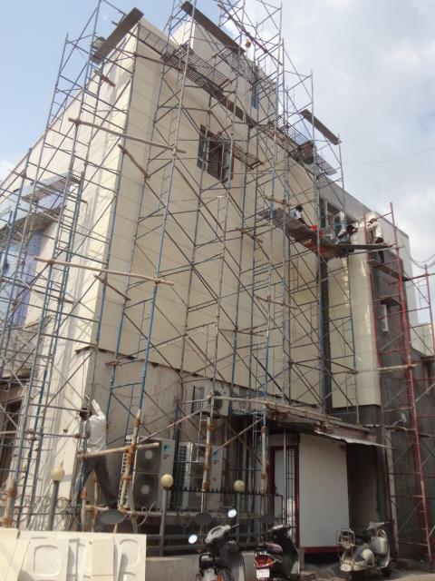
GRC PANELS BEING CLADDED

Slide 15
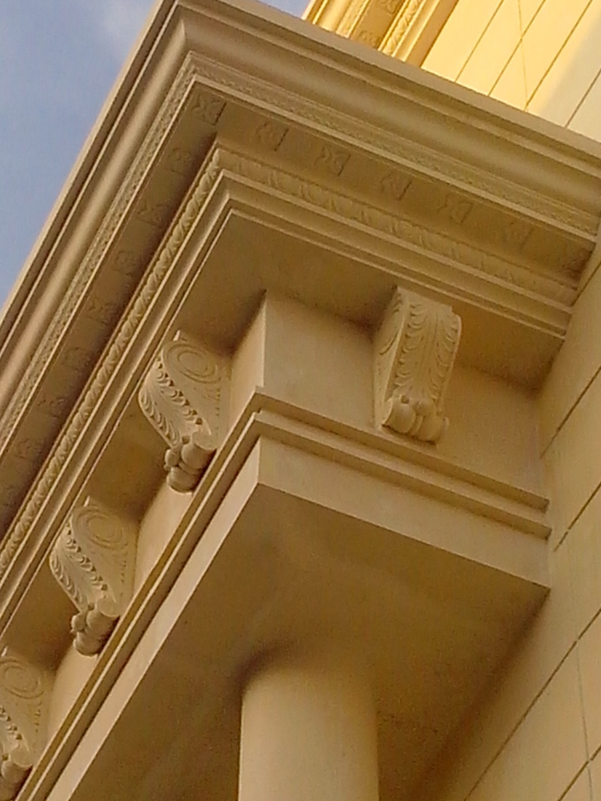
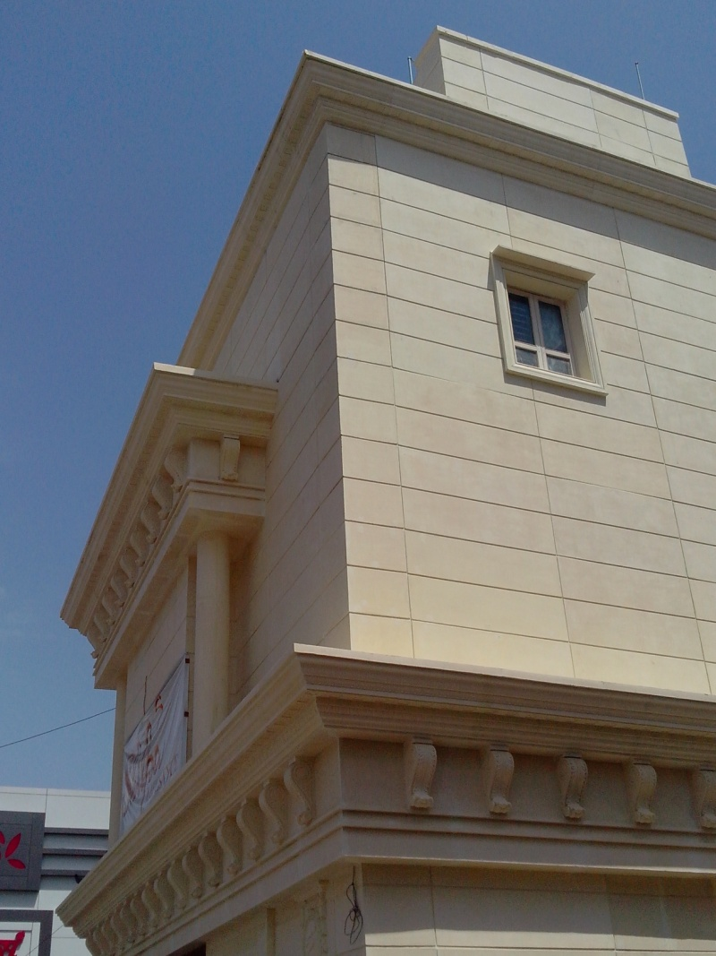
GROOVES RECOMMENDED
BETWEEN PANELS TO AVOID HAIRLINE CRACKS

Slide 16
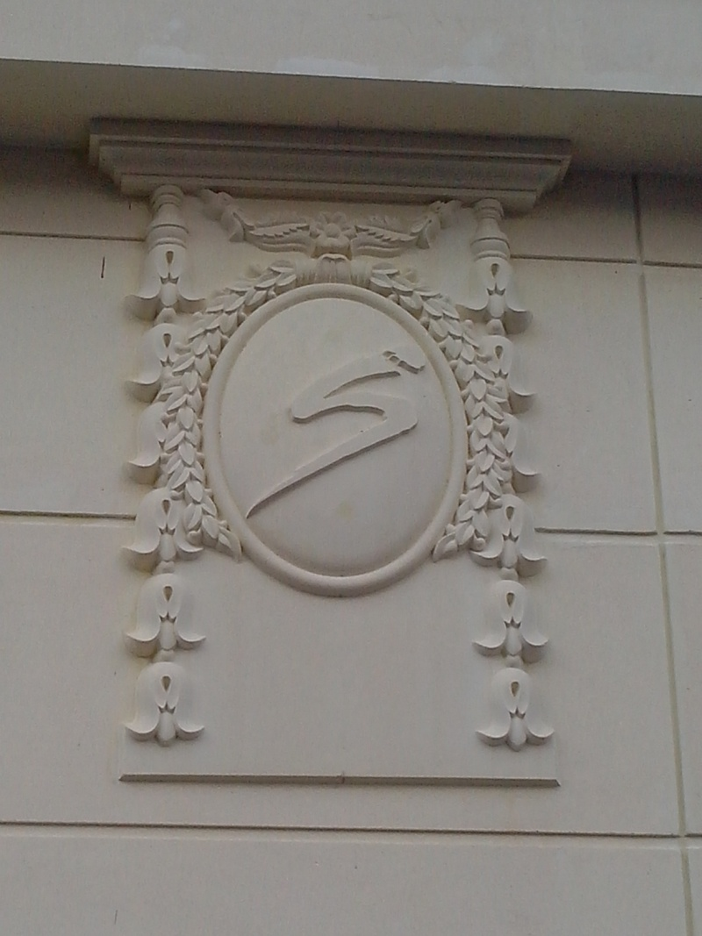
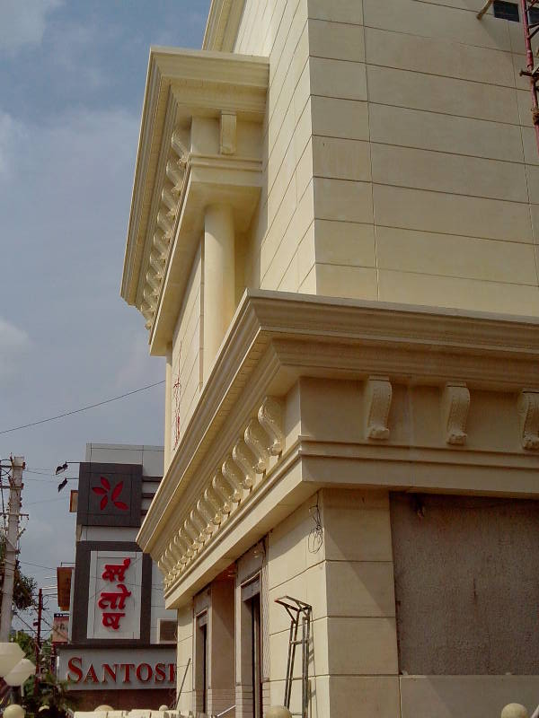
DECORATIVE PANEL WITH LOGO

Slide 17
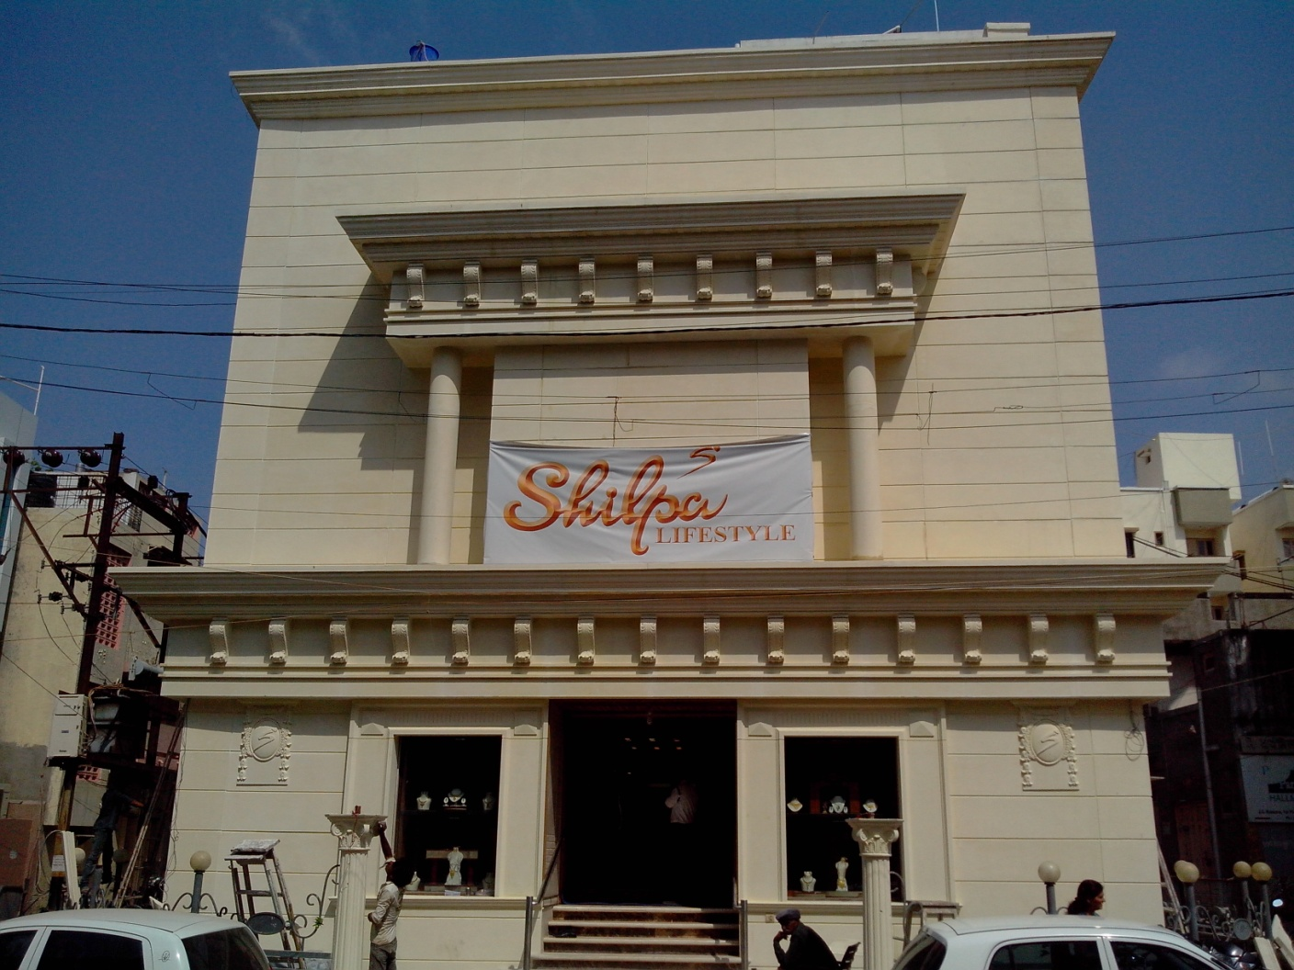
CREATING LANDMARKS WITH GRC

Slide 18
CONTACT DETAILS
GFRC FACADES.
GFRC / GRC, GRG CEILINGS & PANELS, FRP WORKS, HIGH END DECORATIVE & ARCHITECTURAL WORKS & ACOUSTIC SOLUTIONS WITH EXPERTISE IN HOME THEATRES
SRIHARI NILKAR
MUMBAI
Mobile: 09867569395
nilkarsrihari@gmail.com

